Slide 1
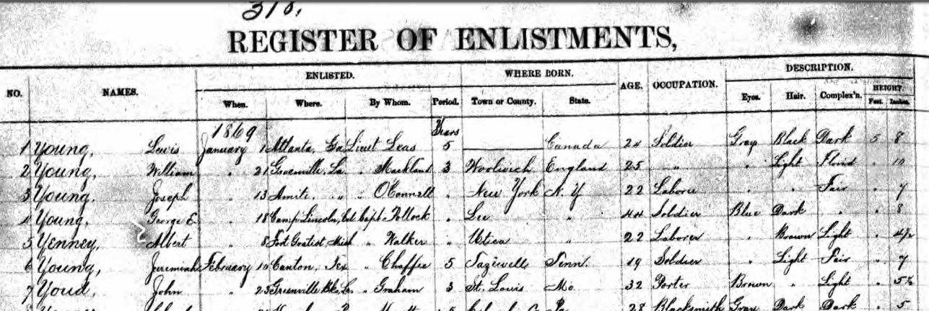
George E. Young Register of US Army Enlistments, Jan 1869
Enlisted Where Born Description Height
No Names When Where By Whom Period Town or County State Age Occupation Eyes Hair Complex’ Feet Inches
4 Young, George E. Jan 18, 1869 Camp Lincoln, Cal Capt. Pollock 3 Years Lee, NY 44 Soldier Blue Dark Fair 5 8

Slide 2
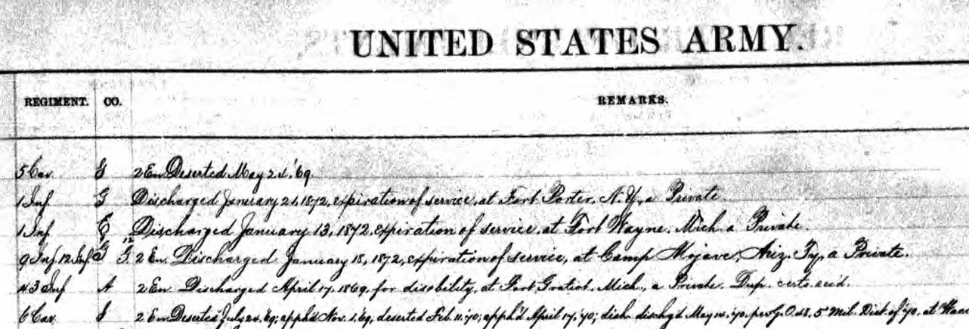
Regiment Co Remarks
9 Inf 12 Inf G G¹² 2nd Enlistment. Discharged January 18, 1872, expiration of term of service, at Camp Mohave, Ariz Ty., a Private

